Slide 1
Exclusive Economic Zone (EEZ)
Understanding the Legal and Economic Implications
Presented by-
Sourav Das (Batch CF O66)

Slide 2
Title and Content Layout with List
What is an EEZ?
Geographic Extent of an EEZ
Rights and Responsibilities within the EEZ
Economic Activities within the EEZ
Environmental Impact and Sustainability
Disputes and Conflicts
Case Study - South China Sea
Conclusion

Slide 3
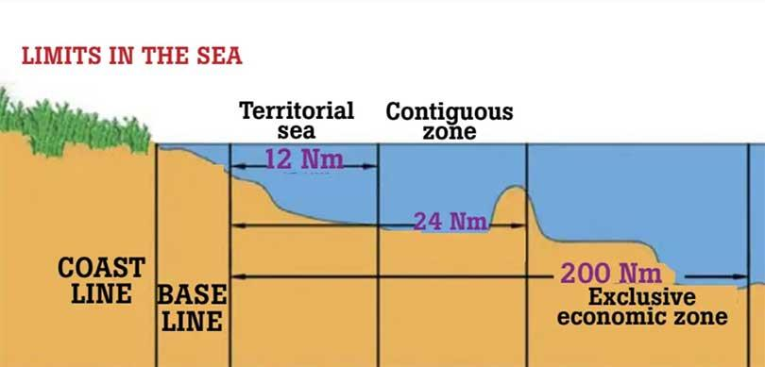
Exclusive Economic Zone
An “exclusive economic zone,” or “EEZ” is an area of the ocean, generally extending 200 nautical miles (230 miles) beyond a nation's territorial sea, within which a coastal nation has jurisdiction over both living and nonliving resources.
EEZs are part of the United Nations Convention on the Law of the Sea (UNCLOS).
Coastal countries have sovereignty over their EEZ, but not territorial sovereignty (meaning they don't control the airspace or the seabed )

Slide 4
Geographic Extent of an EEZ
The EEZ extends 200 nautical miles from the baseline, which is generally the low-water line along the coast.
If two countries' EEZs overlap, they must negotiate to define the boundaries.
In special cases, such as small islands, the EEZ may be less than 200 nautical miles.
Question and Answering
Presented by-- Sourav Das ;Batch 066

Slide 5
Rights and Responsibilities within the EEZ
Exclusive Rights:
Marine Resources: Fishing, oil, gas, and minerals.
Marine Research: Scientific exploration and research activities.
Environmental Protection: Manage marine and coastal ecosystems.
Responsibilities:
Ensure sustainable resource management.
Prevent pollution.
Prevent conflicts with neighboring countries.

Slide 6
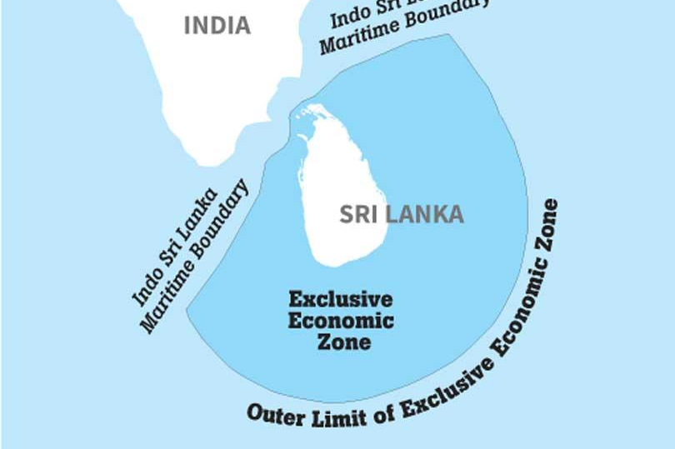
EEZ Sri Lanka
Outer Limit of Exclusive Economic Zone including Maritime Boundary

Slide 7
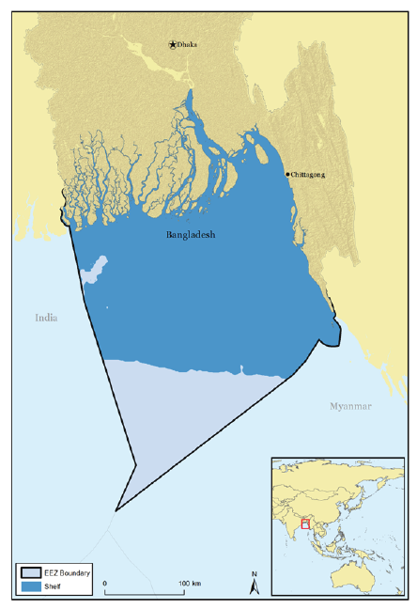
EEZ Bangladesh
Outer Limit of Exclusive Economic Zone including Maritime Boundary with India and Myanmar.

Slide 8
Economic Activities within the EEZ
Fishing | Energy Exploration | Shipping Routes
Coastal states control fishing activities and can limit foreign vessels. | Oil and gas exploration can take place in the EEZ, with rights to drilling and resource extraction. | EEZs do not affect freedom of navigation, but states can regulate activities like underwater mining or fishing to ensure the sustainable use of marine resources.

Slide 9
Disputes and Conflicts
Maritime Boundary Disputes When EEZ boundaries overlap, states must resolve issues through negotiation or legal means (International Court of Justice, arbitration).
Examples:
Disputes in the South China Sea.
Arctic EEZ claims related to sea ice melt.

Slide 10
Distribution of Environmental Impacts in EEZs

Slide 11

Case Study - South China Sea
Overview: The South China Sea is a region rich in natural resources and a key shipping lane. Several countries claim overlapping EEZs, leading to ongoing conflicts.
Countries Involved:
China, Vietnam, Malaysia, the Philippines, Brunei, and Taiwan.
Dispute Elements:
Territorial sovereignty over islands and the rights to exploit resources within overlapping EEZs.

Slide 12


Benefits of an EEZ
Economic Growth:
Access to vast marine resources that can support industries such as fisheries, energy, and tourism.
National Security:
Control over valuable marine areas can enhance national security, especially when it comes to protecting resources and strategic shipping routes.
Environmental Stewardship:
EEZs give coastal states the power to implement policies that protect marine biodiversity and combat pollution.
This Photo by Unknown Author is licensed under CC BY

Slide 13

Conclusion
The EEZ is a crucial part of the global maritime law system, balancing the interests of coastal states and the international community. It provides economic opportunities but also necessitates careful management to prevent disputes and ensure sustainability.
Understanding the EEZ is essential for navigating global issues such as resource competition, environmental conservation, and international relations.
Click START to jump into first page
START

Slide 14


Q&A
Feel free to ask any Question!

